Slide 1
Woodland Public Schools
Facilities and Safety
April 2017 report

Slide 2
FACILITIES REPORT
Summer work
We will continue to focus on building exteriors to protect the infrastructure of our buildings. This summer I am ramping the paint team from 2 to 6 employees. Major items planned for this summer include:
Paint and reside PO 2/3, 4/5, 6/7 Portable 11/12 will require major renovation, roof, siding paint ramps mold mitigation.
Add sidewalk to Green Gym from end of Green Hall
Multiple paving projects including seal coating existing paved areas and new pavement
Sandblasting areas at WPS and WIS that were tagged and painted over. We will apply a treatment that seals the brick or concrete to prevent tagging from sticking.
Roofing replacement and repairs at WPS and WMS
Carpet replacement at WMS and select area in the K-wing at WPS
Camera system WPS (in progress) WIS and WMS
Portable install WIS
Paint building A WMS (wood shop, metal shop and IT building)
Prepping portable 461 and 463 at WMS for ELL and staff offices
LED conversion Green hallway, Yellow hallway and Commons
Numerous other projects around the district (60 in all)

Slide 3
Facilities Report Continued
Card key access system
Systems are up and running at WPS and WMS. We will move forward with WIS next week
WIS still needs to have the FOB systems removed along with the magnetic locks (employee access points only). Key pads will replace the existing internal FOB access points. This work is scheduled for Wednesday 5/17. Installation was pretty uneventful so far and most employees seem to like the easy access to the buildings (if they are badged). We have identified a few areas that need to be added, DO inner door and Special needs access at WPS.
Camera systems
8 cameras are installed at WPS, Getting ready to install WIS cameras next and will tackle the WMS complex during the summer. We are doing this project with in house labor as time permits, which is somewhat slowing down the progress of this work
Portable install
WPS Permits in hand, final grade complete, well outer collar removed and well head cut to grade. Received low voltage/simplex and fire quotes yesterday and plan to issue PO’s this week. Once high voltage plans are done they will be sent to department of Labor and Industries for plan review. I expect this to happen next week.

Slide 4
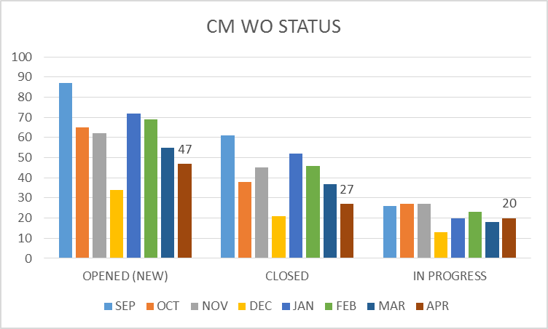
FACILITY CHARTS – POWER COST AND WORK ORDER STATUS

Slide 5
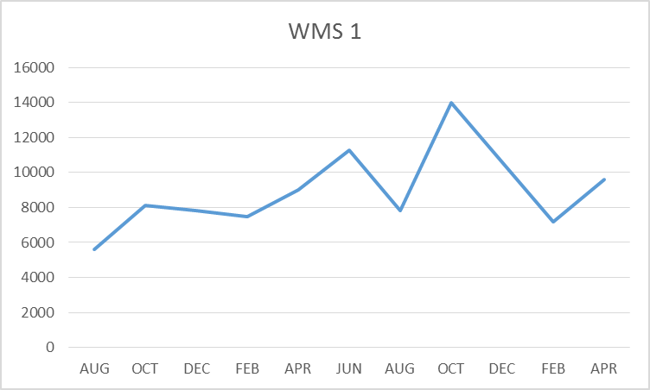
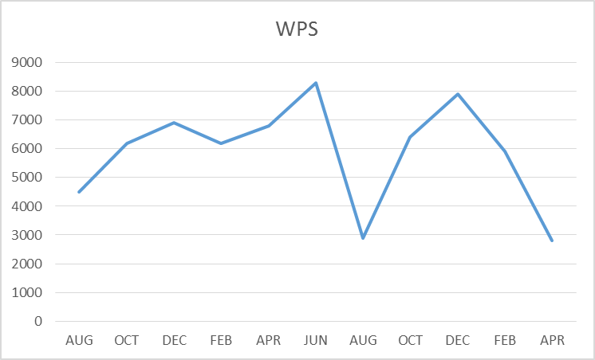
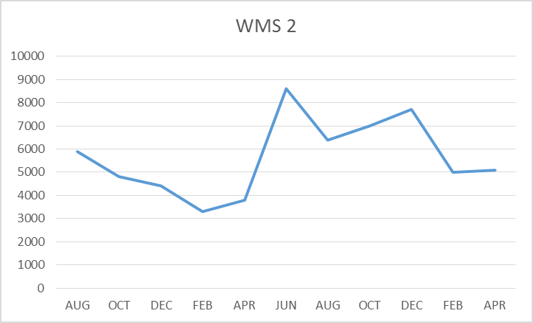
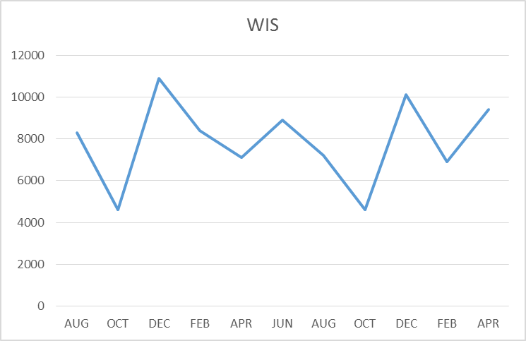
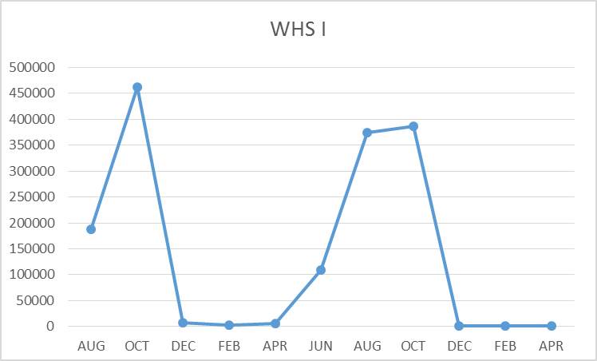
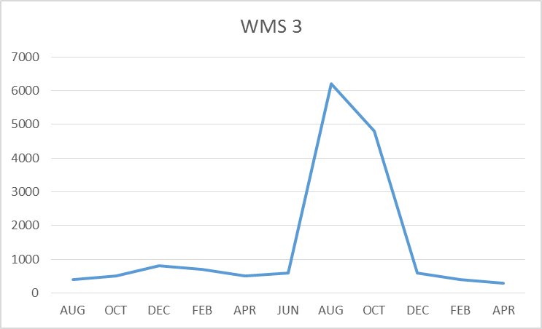
FACILITY CHARTS – WATER USAGE WHS, WIS, WMS, WPS

Slide 6
SAFETY
Accidents for the month
There were a total of 6 injuries/incidents in the month, 4 student, 2 Staff
Staff Accidents/Incidents (2)
WHS – Employee hit knee on podium
WPS – Employee was kicked during de-escalation activity
Student Accidents/injuries (4)
WHS – Student injured collar bone when playing soccer
WHS – Student dropped weight on foot while moving them
WPS – Student slipped on play structure bruised
WPS - Student got foot stuck on spiral bar on play structure

Slide 7
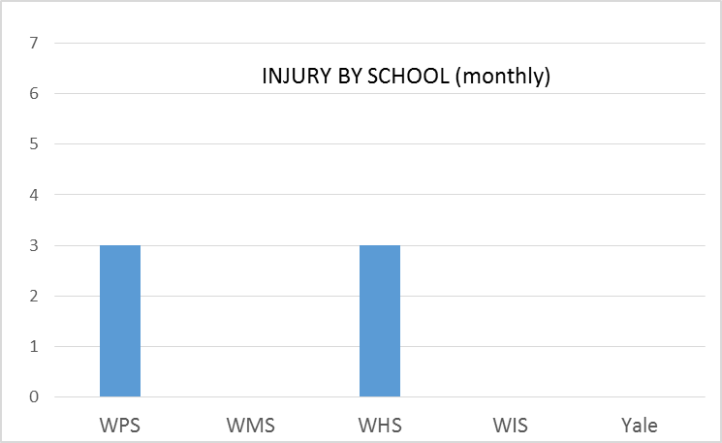
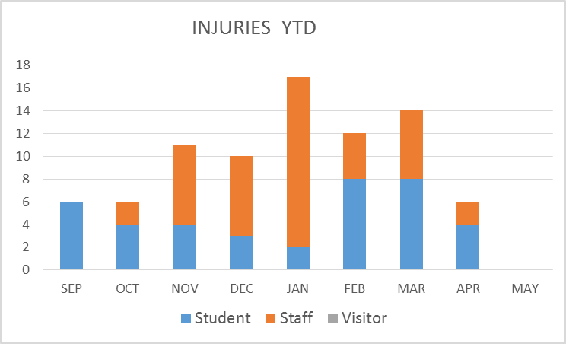
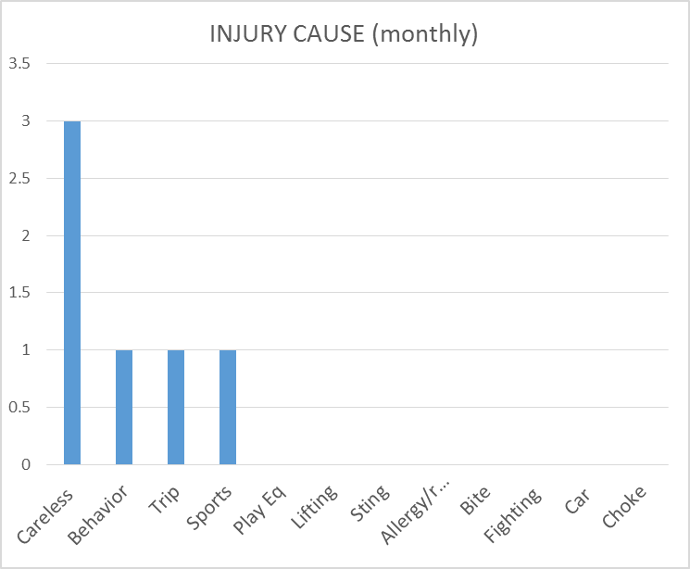
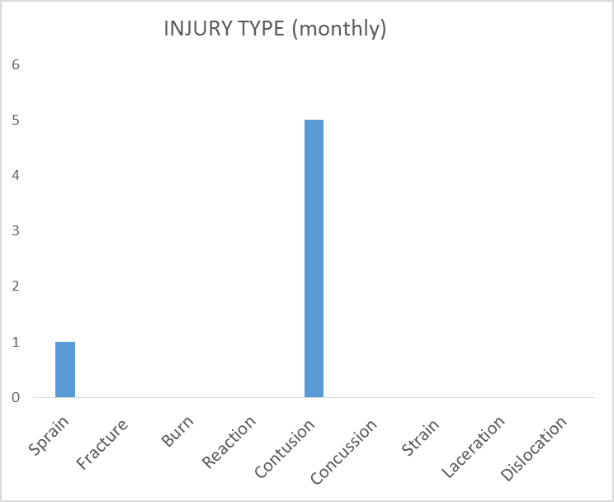
SAFETY CHARTS

